Slide 1
By Rebecca Bray
Evaluation Question 6

Slide 2
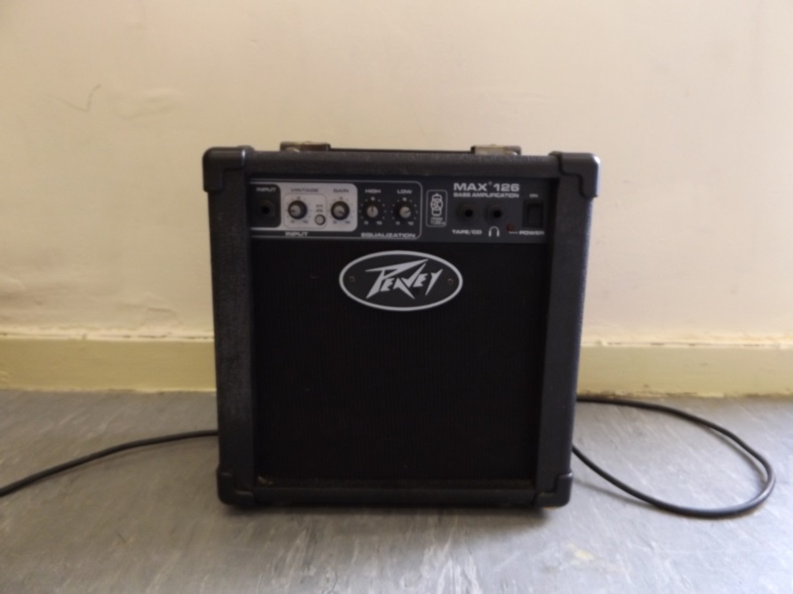
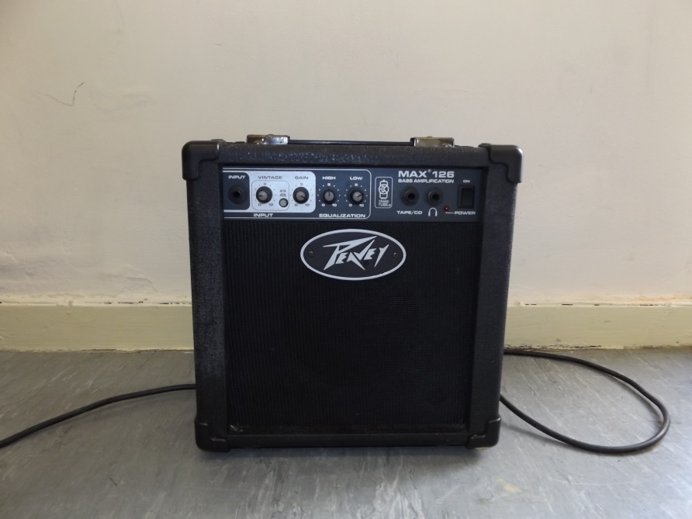
Hardware
I have learned how to operate and use my camera to achieve different images. I have learnt how to use the flash effectively on a number of images. I have done this by researching and practicing taking images before the shoots. I think that this has helped me to get images that look detailed, high quality and professional for my magazine. Without the research and practice I wouldn’t have been able to capture as many good images that I did in the different shoots.
The left image didn’t use flash and became blurred to look at, whilst the photograph on the right had used flash and captured the amp well showing off the detail of the object.

Slide 3
Software
I have used Adobe Photoshop CS6 to create my media product.
I have learnt how to edit my photographs effectively for the front cover, contents and double page spread. I have done this by asking for help from teachers and also researching how to achieve different effects on my images.
I have learnt how to use different types of tools in different ways in order to edit my images. I have learnt how to use the selection tool and lasso tool that allowed me to select certain parts of my image to change. I have learnt how to use the text tool effectively to get all the text I wanted to have onto my pages. I have learn how to use the free transformation tool to resize and rotate images. I have learnt how to use the healing tool and fill tool to remove marks by selecting them and filling them in with the content aware selection. I have learnt how to use the blur tool and sharpen tool effectively to remove marks and to sharpen parts of the image which I think needed to be sharp for my audience.
I think that I have gained more confidence, control and skills within the Photoshop software that allows me to be able to edit my images more successfully. I will keep these skills with me to help to edit more work and projects.
I have learnt how to use the lasso tool, healing tool, selection tool, free transform path, blur tool, burn tool and shape tool.
I think that my development of photographs shows how I have developed my skills in Adobe Photoshop. I think that this shows because you can see how the steps of the development has changed my final image used in my music magazine.

Slide 4
Internet Sites
To post my media product and create a blog I have used www.wix.co.uk
This was my first time using this site to publish my work on a blog. As I am not used to blogging I did some research before hand on how I could layout my work and how to present my work to the readers. With this in mind I could then start to design my Wix pages in order to fit in and show my product in the different parts of the process including the research, planning and final piece.
I had some difficulties with the site sometimes not being able to save my work which I then had to fix in my own time in order to stay on task with the media product. I found that this knocked me back with some parts of my work as I kept having to repeat my work as the pages sometimes wouldn’t save.
I also used google to help me research and collect ideas for creating my media piece. This research is included on my blog and has really helped me to produce my music magazine. I found out a lot of helpful research on front covers, contents, pages, double page spreads and the different features that are used in the magazines.
When coming to creating my evaluation of the final product I used many different sites to find different ways to present my answers to the questions. I have used Prezi, Powtoon, Popplet, Padlet and Microsoft PowerPoint. I have chosen these to present my work as I think that these sites present my media product differently. I also feel like I can explain my work better using different types of websites as they all differ from each other.

